Slide 1

Windows PowerShell
System administration and automation in a Windows environment
- Basic -
Karin De Maertelaere, Jochen Mariën

Slide 2
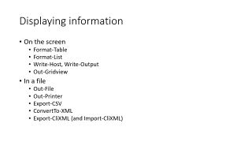
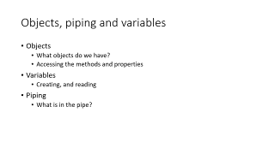
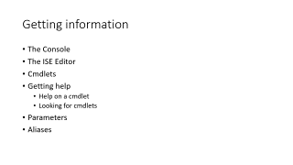
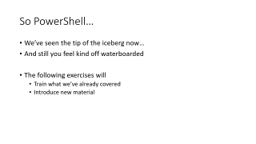
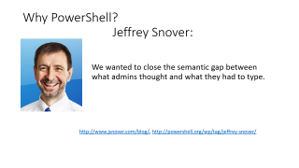
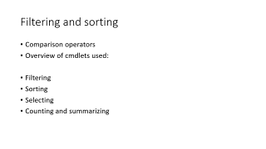
Contents

Slide 3

Why PowerShell? Jeffrey Snover:
We wanted to close the semantic gap between what admins thought and what they had to type.
http://www.jsnover.com/blog/, http://powershell.org/wp/tag/jeffrey-snover/

Slide 4

Why PowerShell? Don Jones:
Right now, you've got a choice if you want to remain relevant as an IT professional:
Learn Windows PowerShell,
or learn ‘Do you want fries with that?’
http://donjones.com/, http://powershell.org/wp/tag/don-jones/

Slide 5
Why PowerShell?
Dos:
A lot of differently styled commands
No filtering, only text-based
Inconsistent use of parameters
Get files and folders:
DIR
Get-ChildItem
Get all running processes:
Tasklist
Get-Process
Get all services
Sc query
Get-Service
Get all users in active directory
Dsget user …
Get-ADuser
PowerShell:
The same cmdlet-structure
Filtering on any property
Consistent use of parameters

Slide 6
History
PowerShell v1.0:
Server 2003 and 2008, Windows XP SP2 and Vista
A first try, not ready for production
PowerShell v2.0
Server 2008 R2, Windows 7
A good version, production ready
PowerShell v3.0
Server 2012, Windows 8
A better version, (almost) complete server management
Later versions (v4.0, v5.0)
No groundbreaking alterations to v3.0
A lot of features added

Slide 7
Windows PS vs PS Core
Windows PowerShell
What it all started with
Closed source
Only works on windows with the full .Net framework
PowerShell core
The next thing
Open source, on github
Works with the .Net core framework (https://www.microsoft.com/net/core)
Works on (normal) Windows, Nano, Linux, Mac, …

Slide 8
Windows PS vs PS Core
https://www.youtube.com/watch?v=myQkHM_je70
Windows PowerShell is done
All the functionality is there
But the goal is to manage any operating system, on any hypervisor
Also, devops: have the devs and opsers speak the same language
This only works when the opsers always speak powershell
PS Core is opensource and community driven
Not yet, but getting there
Editor: Visual Studio Code

Slide 9

Windows PS is done?
It really is – you can run and manage an entire domain without using a single server with a GUI
“But I don’t want to, because clicking is nice”
You can run the GUI on a client (where it belongs) and manage the servers using the normal tools
AD Users and computers, server manager, …
But you shouldn’t, because scripting a task is the best documentation you’ll ever make
Also: the cultural battle to remove Windows from Windows Server
https://www.youtube.com/watch?v=3Uvq38XOark

Slide 10
Getting information
The Console
The ISE Editor
Cmdlets
Getting help
Help on a cmdlet
Looking for cmdlets
Parameters
Aliases

Slide 11
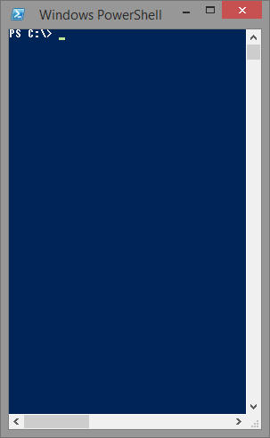
The console
Copy / Paste, not the default keystrokes
Mark and Enter
Right-click
‘Fixed’ in v5
Little assistance when typing
Small, takes up very little memory
Asks no more .NET framework than PS itself

Slide 12
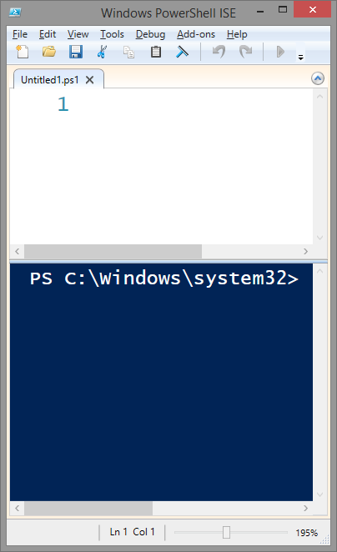
The ISE editor
Copy / Paste, default keystrokes
Ctrl C
Ctrl V
More assistance when typing
Better for zooming in
Requires more time to load
Requires WPF, doesn’t work on server without GUI

Slide 13
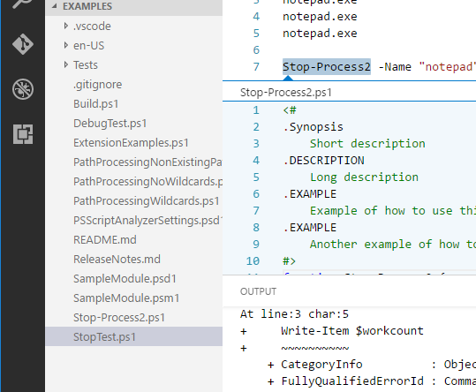
Visual Studio Code
A new editor that is supported on any OS, and supports a lot of languages through extensions

Slide 14
cmdlets
PowerShell introduces a new type of command: the cmdlet
A cmdlet [commandlet] is a small, condensed piece of functionality
It’s always of the form verb-noun
Get-Item
Stop-Process
Restart-Computer

Slide 15
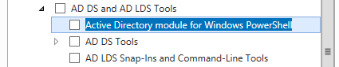
cmdlets
Where do the cmdlets come from?
All cmdlets are grouped in DLL’s, snapins or modules
Default: MS.PS.Utility and MS.PS.Management
You can install additional modules
For example, in server 2012 R2, add roles and features wizard:
Once installed, modules are loaded automatically

Slide 16
cmdlets
Why the modules?
Because you can manage everything with PS, but not on every computer
It’s useless to install the “New-ADUser” on every computer, because it only has a point on Domain Controllers
So, when you need “New-ADUser”, you can install the remote server administration tools, and the module will become available
The basic cmdlets are available on every computer
This introduction focuses on those cmdlets

Slide 17
cmdlets - First exercises
All processes
All running notepad processes
All processes starting with ‘N’
Stop all notepads that are running
Check what processes would have been stopped when you stop all processes beginning with ‘N’

Slide 18
cmdlets - First solutions
Get-Process
All processes
Get-Process –name ‘Notepad’
All running notepad processes
Get-Process –name ‘N*’
All processes starting with ‘N’
Stop-Process –name ‘Notepad’
Stop all notepads that are running
Stop-Process –name ‘N*’ -WhatIf
Check what processes would have been stopped when you stop all processes beginning with ‘N’

Slide 19
Getting help on a cmdlet
Google
Get-Help cmdlet
Worked fine in v2.0, but starting from v3.0 the help-files have to be downloaded first with update-help…
… and even then not all the information, like the examples are available
Get-help cmdlet –online
Will open the technet-page on that cmdlet, with all information and examples
Great when you are not working on a server [core]

Slide 20
Getting help finding a cmdlet
Google
Get-Command -name “*…*”
Works when what you want to work with is in the name of the cmdlet, which isn’t always the case
“I want to reboot my operating system” -> restart-computer
Get-help About_Aliases
Should work, but doesn’t
The technet page works, and has all information on creating or removing aliases
The PowerShell module browser
https://docs.microsoft.com/en-us/teamblog/announcing-unified-powershell-experience
Basically a well organized website for finding cmdlets…

Slide 21
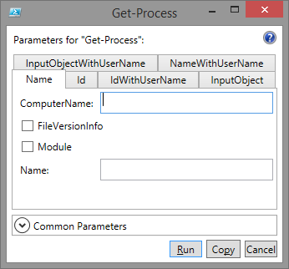
More help
Show-Command cmdlet
Shows a window where you can enter data, and copy the resulting command
For example, Show-Command Get-Process:
The ISE has a similar window in the sidebar

Slide 22
Parameters
All parameters are interpreted as strings
Double quotes are always permitted, but only obligated when an blank (“ ”) is used in the parameter
Get-ChildItem “C:\Program Files”
“Switches” are parameters without a value
Get-ChildItem “C:\Program Files” –recurse
You can use a named parameter, or a positional
Get-ChildItem “C:\Program Files”
Get-ChildItem –path “C:\Program Files”

Slide 23
Named vs positional parameters
“Get-Process notepad” works
Get-Help Get-Process -Online
-Name<String[]> -> Position? 0
“Stop-Process notepad” doesn’t
Get-Help Stop-Process -Online
-Name<String[]> -> Position? Named
When in doubt, use named parameters
It’s best to always use named parameters, but sometimes you just don’t feel like typing

Slide 24

Calculated parameters
You can calculate parameters ‘on the fly’
Get-ChildItem ($pshome + "\modules\DnsClient")
The brackets are mandatory
The “+” is seen as a separator for parameters
When concatting strings, you could have used…
Get-ChildItem "$pshome\modules\DnsClient"
Variables are resolved within strings
Use brackets to calculate anything
Get-Process –id (1400+100)
Stop-Process -id ( Get-Random -Minimum 100 -Maximum 5000 ) -WhatIf

Slide 25
Partial parameters
You don’t have write out the full parameter name, it’s ok to uniquely identify it…
This is especially useful if:
The ctrl-space-combination on your keyboard is broken
You want to be that colleague
Your SSD is so full that not saving the extra characters is going to make a difference
Get-Process -name powershell_ise
Get-Process -na powershell_ise

Slide 26
Wildcards
You can use wildcards in any parameter
Get-help about_wildcards
https://technet.microsoft.com/en-us/library/hh847812.aspx
Zero or more characters: *
One character: ?
One character in selection: [vx]
V or X
One character in range: [v-x]
V, W or X
Regular expressions only with “-match”

Slide 27
Exercises
Get all services starting with “win”
Get all services called “w_nrm”, having a random character for the underscore
Get all services starting with V or X
Get all services starting with V, W or X
Get all services containing “w_n”, with anything but a vowel for the underscore

Slide 28
Exercises - solutions
Get-Service win*
Get-Service w?nRM
Get-Service [vx]*
One character in selection: [vx]
The * makes sure we only look at the first letter
Get-Service [v-x]*
One character in range: [v-x]
Get-Service | Where-Object Name -Match "W[^aeiou]n”
Regular expression!

Slide 29
Aliases
An alias is a different, shorter name for a cmdlet
Some aliases have been predefined
Get-Alias
You can create your own aliases
New-Alias, Set-Alias
But that makes the script you create unusable on another computer
Useful default aliases:
FT: Format-Table
FL: Format-List

Slide 30
Displaying information
On the screen
Format-Table
Format-List
Write-Host, Write-Output
Out-Gridview
In a file
Out-File
Out-Printer
Export-CSV
ConvertTo-XML
Export-CliXML (and Import-CliXML)

Slide 31
Format-Table, Format-List
Get all processes, and show name and CPU-usage in a table:
Get-Process | Format-Table name, CPU –Autosize
Get all processes, and show name and CPU-usage in a list:
Get-Process | Format-List name, CPU
What properties can I show?
Get-Process | Get-Member -MemberType Properties
Difference between “Property”, “AliasProperty” and “ScriptProperty”? Read about the ETS

Slide 32
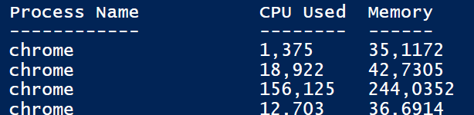
Format-Table – Hash tables
$proces=@{
Label="Process Name";
Expression={$_.name};
alignment="left"}
$cpu=@{
Label="CPU Used";
Expression={$_.CPU};
FormatString="N3"}
$mem=@{
Label="Memory";
Expression={$_.PM/1MB}}
Get-Process | Format-Table $proces,$cpu,$mem -autosize
Notes:
$proces=@{Label="Process Name";Expression={$_.name};alignment="left"}
$cpu=@{Label="CPU Used";Expression={$_.CPU};FormatString="N3";alignment="left"}
$mem=@{Label="Memory";Expression={$_.PM/1MB};FormatString="N4";alignment="left"}
Get-Process | Format-Table $proces,$cpu, $mem -autosize

Slide 33
Write-Host, Write-Output
Write text on the screen: type and execute the text
“Hello”
In a script, use Write-Host or Write-Output
Write-Host | Write-Output
-NoNewLine | No –NoNewLine
Colors can be set | Colors can’t be set
Outputs to the host | Outputs to the pipeline
Can’t be redirected | Can be redirected

Slide 34
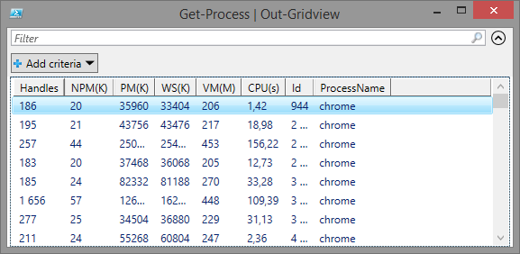
Out-Gridview
Shows a sortable gridview of the input-objects
Can be passed through to the next item in the pipeline
Get-Process | Out-Gridview

Slide 35
Exercises
Show name, CPU-usage and (nonpaged)memory of all processes starting with “N”
Show all services starting with “A” in a list
Write your name on the screen, in red with a green background (what Joe, Jack, William and Averell won’t like)
Show all services with startuptype “automatic” that are not running in a gridview
Make sure you can click “ok” in above gridview to start these services

Slide 36
Exercises - solutions
Get-Process -name “N*" | Format-Table name, cpu, npm –AutoSize
Get-Service -Name "A*" | Format-List
Write-Host “Lucky Luke” -ForegroundColor Red -BackgroundColor Green
Get-service | Where-Object Starttype -EQ Automatic
Get-Service | Where-Object { $_.starttype -eq "Automatic“ -and $_.status -eq "Stopped" } | Out-GridView -Title "Start which?" -PassThru | Start-Service

Slide 37
Writing to files
“The DOS-way” still works
Get-Process > c:\tmp\processes.txt
But Out-File is better
Get-Process | Out-File -FilePath c:\tmp\processes.txt
Also: encoding, append, force (against readonly), …
Really liked the matrix-printer days?
Get-Process | Format-Table … | Out-Printer
Or Excel?
Get-Process | Export-Csv -Path c:\tmp\processes.csv -Delimiter ";"

Slide 38
Exporting to XML
Export-CliXML
Exports to XML
Is not meant to be readable
Can be imported
Import-CliXML
Imports the object from the XML file as objects of the original type
ConvertTo-XML
Converts anything to (readable) XML
Can be written to a file, but it’s difficult

Slide 39
Exporting to XML
Export all processes, then import them and show them in a table:
Get-Process | Export-Clixml -Path "c:\tmp\proc.xml"
Import-Clixml -Path "c:\tmp\proc.xml" | Format-Table Name, cpu, npm -AutoSize
Export all process to an XML-file meant for reading
$xml = Get-Process | ConvertTo-Xml -NoTypeInformation
$xml.Save("c:\tmp\nice proc.xml")

Slide 40
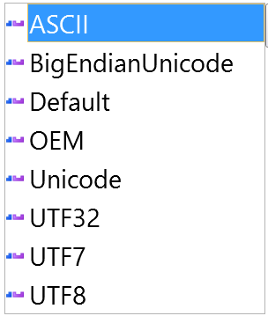
Encoding
You can add an encoding to most cmdlets
But only an encoding in the list
If you want fancy encoding (e.g. eurosigns), use the io.file class:
Export-Csv -Path $file -Encoding UTF8
$file = "c:\tmp\file.txt"
$text = "You owe me 34€."
$encoding = [System.Text.Encoding]::GetEncoding(1252)
[io.file]::WriteAllText($file, $text, $encoding )
Notes:
This example also works with default UTF8-encoding, but it won’t when reading the tekst from a file in the ‘wrong’ encoding…

Slide 41
Objects, piping and variables
Objects
What objects do we have?
Accessing the methods and properties
Variables
Creating, and reading
Piping
What is in the pipe?

Slide 42
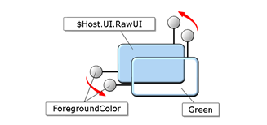
Objects
$Host.UI.RawUI.ForegroundColor = "green"
Notes:
Restore:
https://blogs.technet.microsoft.com/heyscriptingguy/2015/11/13/set-powershell-ise-to-default-values/
$psISE.Options.RestoreDefaults()
$psISE.Options.ErrorBackgroundColor = "Red"
$psISE.Options.ErrorForegroundColor = "White"

Slide 43
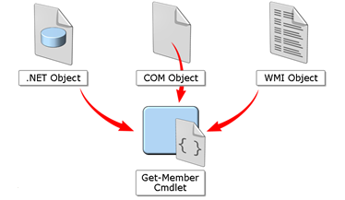
Objects
PowerShell wraps any type of object in a PSObject
This means they can be handled the same…
Get-Process
Get-CimInstance -ClassName Win32_Process

Slide 44
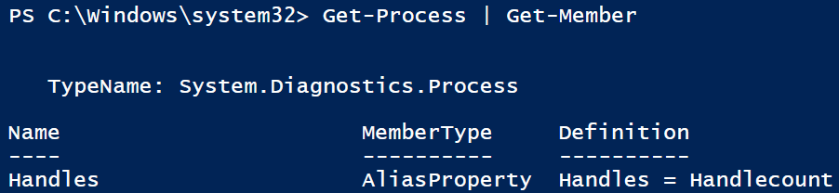
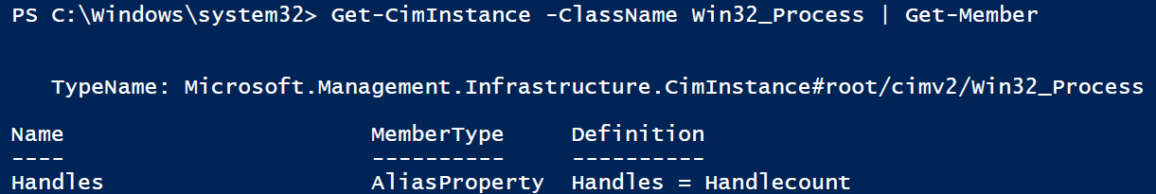
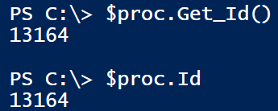
What object am I looking at?
Get-Member
Shows:
The typename
All methods
All properties
-Force
Also shows the intrinsic members
And the compiler-generated methods
Not required, as you can get them with the base members as well

Slide 45
Get-Date
Get-Date gives you a System.DateTime object
Has a property “DayOfWeek”
Putting brackets around Get-Date will allow you to access these properties
(Get-Date).DayOfWeek
… and methods
(Get-Date).AddMonths(4)
Starting from v3.0, this also works when you have multiple objects
(Get-Process).name

Slide 46
Creating and reading variables
Create a variable: assign a value
$a = 5
And change the datatype on the fly
$a = “A string”
So $a was a string all along?
No, test with $a.getType()
Programmers hate this kind of behavior
Scripters like the quick-and-dirtyness

Slide 47
Creating and reading variables
The Get-Date example is much more readable with variables
$today = Get-Date
$today.DayOfWeek
$today.addMonths(4)
You can also use variables to store a list of objects
$procs = Get-Process
$procs | Format-List
Using variables will increase the readability of a script

Slide 48
Date exercises
The doctor says the sixth week started yesterday. When will the magic happen?
What day is the first of July this year?
Can you make sure the above command also works next year?
How long until the first of July?
What type of object do you get from the previous exercise? Could you have done the calculation in one line?
The Christmas break starts the first Saturday before the 24th of December. Select that day for any given year.

Slide 49
Date solutions
The doctor says the sixth week started yesterday. When will the magic happen?
(Get-Date).AddDays(-1).AddDays(7*(40-5))
What day is the first of july this year?
Get-Date "1/7/2018“ # Will only work on a Belgian computer
Get-Date -date "1_7_2018" -Format "d_M_yyyy“ # never works
Get-Date -Day 1 -Month 7 -Year 2018 # always works
$a=[datetime]::ParseExact("01/02/03", "dd/MM/yy", $null) # also always works
Can you make sure the above command also works next year?
Get-Date -Day 1 -Month 7 -Year (Get-Date).Year
How long until the first of july?
$then = Get-Date -Day 1 -Month 7 -Year (Get-Date).Year
$now = Get-Date
$then - $now
What type of object do you get from the previous exercise? Could you have done the calculation in one line?
$then - $now | Get-Member
New-TimeSpan -Start (Get-Date) -End (Get-Date "1/7/2018")
The Christmas break starts the first Saturday before the 24th of December. Select that day for any given year.
$date = get-date "24-12-2018"
$date.AddDays(-($date.DayOfWeek.value__)-1)
Notes:
#The doctor says the sixth week started yesterday. When will the magic happen?
(Get-Date).AddDays(-1).AddDays(7*(40-5))
#What day is the first of july this year?
Get-Date "1/7/2018“ # Will only work on a Belgian computer
Get-Date -date "1_7_2018" -Format "d_M_yyyy“ # never works
Get-Date -Day 1 -Month 7 -Year 2018 # always works
#Can you make sure the above command also works next year?
Get-Date -Day 1 -Month 7 -Year (Get-Date).Year
#How long until the first of july?
$then = Get-Date -Day 1 -Month 7 -Year (Get-Date).Year
$now = Get-Date
$then - $now
#What type of object do you get from the previous exercise? Could you have done the calculation in one line?
$then - $now | Get-Member
New-TimeSpan -Start (Get-Date) -End (Get-Date "1/7/2018")
#The Christmas break starts the first Saturday before the 24th of December. Select that day for any given year.
$date = get-date "24-12-2018"
$date.AddDays(-($date.DayOfWeek.value__)-1)

Slide 50
Filtering and sorting
Comparison operators
Overview of cmdlets used:
Filtering
Sorting
Selecting
Counting and summarizing

Slide 51
First, comparison operators
about_Comparison_Operators
You can’t use =, <= and > in PowerShell
You have to use –eq, –le and –gt
To test:
“A” –eq “B”
12 –gt 5
“PowerShell” –like “Po?er[SZ]hell”
Cons: it takes some getting used to
Pros: you have more options (regex!)

Slide 52
Filtering and sorting
Ordered by ‘importance’:
Where-Object | Sort-Object
Select-Object | Group-Object
Measure-Object | ForEach-Object
Compare-Object | Tee-Object
New-Object | Register-ObjectEvent

Slide 53
Filtering
Give me all processes whose name starts with “N”
Give me the process with ID 7589
Give me the process with an ID bigger than 7589
Give me all processes with (exactly) 1 second of CPU-time
Get-Process -Name "N*"
Get-Process -ID 7589

Slide 54
Filtering
When you can use a parameter to filter data, you should
When you can’t, pipe to where-object
Where-Object filters all processes based on any parameter
Which parameters can I use? Get-Member
But “=” doesn’t work!
See three slides ago -> comparison operators
Nice: Dates can be compared to days
Get-Process | Where-Object ID -gt 7589
Get-Process | Where-Object CPU -eq 1
Get-ChildItem C:\tmp | Where-Object LastAccessTime -gt (Get-Date).AddDays(-7)

Slide 55

Filtering
What if I want two filters?
ID bigger than 1000 or exactly 1 second CPU
The syntax we’ve used is the PowerShell v3 (and later) syntax
In PowerShell v2 (and v1) that would have been
Get-Process | Where-Object { $_.ID -gt 7589 }

Slide 56
Filtering
So, ID bigger than 1000 or exactly 1 second CPU
The “$_” stands for every object that is piped in
You can refer to all properties (of properties of…) of the incoming objects
ID, or CPU, or description.length, …
PS: Never say “-eq” when using floats (like CPU). The chance of having a process with exaclty 1 second of CPU-time are slim. Use something like “-gt”.
Get-Process | Where-Object { $_.ID -gt 7589 -or $_.CPU -eq 1}

Slide 57
Filtering v2 vs v3
In v2, every filter had to be a scriptblock
Where-Object { $_.ModuleName -like "*Utility" }
Curly brackets around the filter
$_ to refer to the incoming object
Quotes around every (string) literal
In v3 you can use the ‘simple’ notation if you only have one comparison
Where-Object ModuleName -like *Utility
But you need to use a scriptblock if you have more than one comparison

Slide 58
Where-exercises
Give me all processes that have used more than 1 second of CPU-time
… and that aren’t from Microsoft
Get all aliases about objects
What day was it a month ago?
And which files in c:\tmp have been accessed since that day?
… and are bigger than 1MB?
Or select the following files:
Not written to for a month, and larger than 1 MB OR
Not written to for a year
Sort by descending written to-time
Notes:
If administrator you can use “c:\Windows\Temp” in stead of “c:\tmp”

Slide 59
Where-solutions
# 1
Get-Process | Where-Object CPU -gt 1
# 2
Get-Process | Where-Object { $_.CPU -gt 1 -and $_.Company -notlike "Microsoft*" }
# 3
Get-Alias -Name *Object*
Get-Alias | Where-Object Name -Like *Object*
# Both don’t work! Check members…
Get-Alias | Get-Member
Get-Alias | Where-Object DisplayName -Like *Object*
# 4
(Get-Date).AddMonths(-1)
# 5
Get-ChildItem c:\tmp | Where-Object LastAccessTime -GT (Get-Date).AddMonths(-1)
# 6
Get-ChildItem c:\tmp | Where-Object {$_.LastAccessTime -GT (Get-Date).AddMonths(-1) -and $_.Length -GT 1MB }
# 7
Get-ChildItem c:\tmp -Recurse |
Where-Object {
($_.LastWriteTime -Lt (Get-Date).AddMonths(-1) -and $_.Length -gt 1MB) `
-or ($_.LastWriteTime -Lt (Get-Date).AddYears(-1)) `
} | Sort-Object LastWriteTime -desc

Slide 60
Sort-Object
Sorts objects, based on a property
Get-process | Sort-Object CPU
Ascending by default, or descending by switch
Get-process | Sort-Object CPU -Descending
Using multiple properties
Get-process | Sort-Object Name, CPU

Slide 61
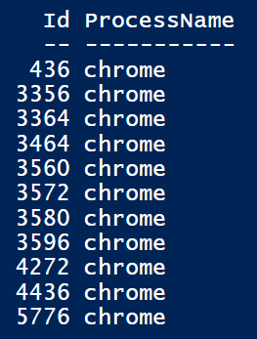
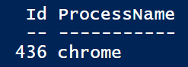
Sort-Object -Unique
Adding –Unique will make sure the property by which we sort is made unique
Get-Process –Name chrome | Sort-Object Name
But it doesn’t care about the other properties
Get-Process –Name chrome | Sort-Object Name -Unique

Slide 62
Select-Object
Select-Object does two very different things:
Select topmost X rows
Throw away certain properties of an object

Slide 63
Select-Object
Stop the five most CPU-intensive processes:
Get-Process |
Sort-Object CPU -Descending |
Select-Object -First 5 |
Stop-Process -WhatIf

Slide 64
Select-Object
Create a CSV-file with the name, CPU and Companyname of every process
Get-Process |
Select-Object Name, CPU, Company |
Export-Csv -Path c:\temp\procs.csv

Slide 65
Select-Object – castrating
Beware, when selecting certain properties with Select-Object you really hurt the project
Get-Process | Get-Member
91 rows
Get-Process | Select-Object Name | Get-Member
5 rows
Castrating an object is only neccesary when you need to remove certain properties
Useful when exporting a list
Not needed when displaying a list (with Format-Table, Format-List, …)

Slide 66
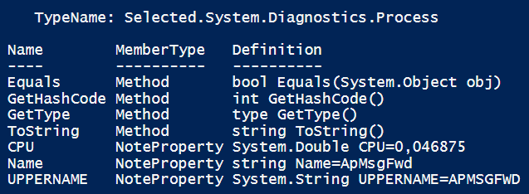
Select-Object – Adding properties
In the same way you remove properties, you could also add some
This removes all properties expect for name and CPU, and adds the name in uppercase
You want to retain all prop’s?
(Pretty slow though…)
Get-Process |
Select-Object Name, CPU, @{Name="UPNAME";Expression={"$($_.name.ToUpper())"}} |
Get-Member
Get-Process |
Select-Object *, @{Name="UPP...

Slide 67
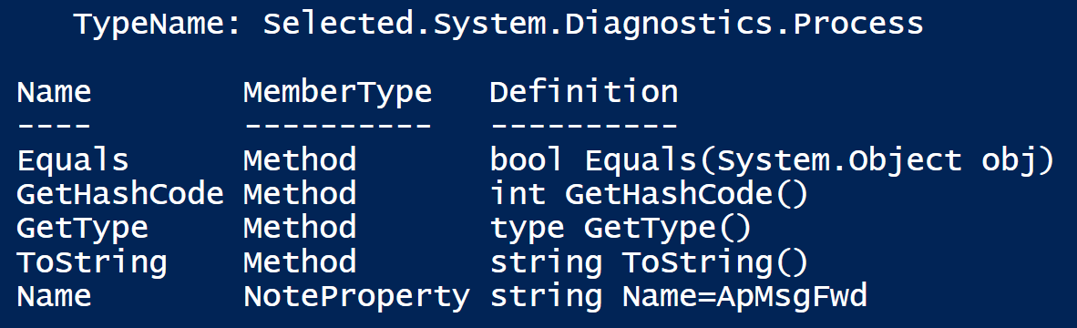
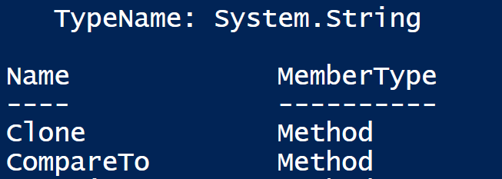
Select-Object -ExpandProperty
ExpandProperty expands the property chosen
Aka it returns the object that is in the property, in stead of an object with that object as a property
An example
Result: A System.Diagnostic.Process-object with one property: Name
In this property the name is stored as a string
Result: A System.String-object
In this object, the name is immediately available
Get-process | Select-Object Name | Get-Member
Get-process | Select-Object -ExpandProperty Name | Get-Member

Slide 68
Select-Object -ExpandProperty
You calculated a sum…
Suppose you want to multiply this number by 2
2 options
Practical application
Get-Process | Measure-Object CPU -Sum
( Get-Process | Measure-Object CPU -Sum ).Sum * 2
( Get-Process | Measure-Object CPU -Sum |
Select-Object -ExpandProperty Sum ) * 2
Get-command Get-process | Select-Object -ExpandProperty Parameters

Slide 69
Another example
All processes:
Now, let’s make a comma-separated list of all names
Doesn’t work
Make a list of objects that have only a name-property
But the list doesn’t contain strings, so can’t be joined
Works
The list now contains only the names, so strings
$proc = Get-Process
( $proc | Select-Object "Name" ) -join ", "
( $proc | Select-Object -ExpandProperty "Name" ) -join ", "

Slide 70
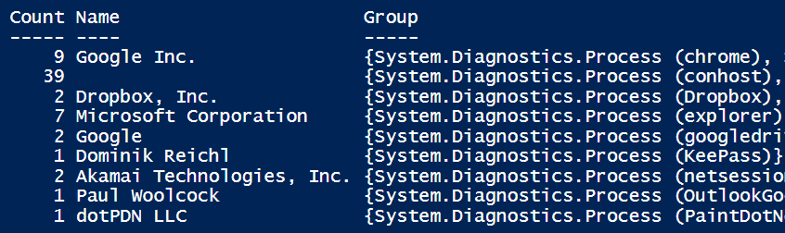
Group-Object
How many processes are running per company?
Get-Process | Group-Object Company

Slide 71
Group-Object
Beware, after grouping, “Name” is the name of the group, not the name of the original object
Get-Process | Group-Object Company | Where-Object Name -eq Chrome
Empty!
Get-Process | Where-Object Name -eq Chrome | Group-Object Company
Result!
Get-Process | Group-Object Company | Where-Object Name -like Microsoft*
Result!

Slide 72
Measure-Object
I have an expensive CPU. How much am I using it?
Get-Process | Measure-Object CPU -Sum
The sum of CPU-time for all running processes
And the average nonpagedmemorysize?
Get-Process | Measure-Object NPM –Average
And both at the same time?
Get-Process | Measure-Object CPU, NPM -Sum -Average
2 objects are returned!
Notes:
Minimum klopt niet bij get-process:
Get-Process | Where-Object CPU -ne $null | Measure-Object CPU -Minimum

Slide 73
Group vs Measure
Group-Object en Measure-Object can both count stuff
How many chrome-processes do I have running?
Get-Process -Name chrome | Measure-Object
Get-Process -Name chrome | Group-Object Name
But Group-Object is for grouping
How many processes do I have per name of process?
Get-Process | Group-Object Name
And Measure-Object is for counting
What CPU-time have the chromes used on average?
Get-Process -Name chrome | Measure-Object CPU -Average
Notes:
Get-Process | where-Object CPU -is [Double] | Measure-Object -property CPU -Minimum -Maximum

Slide 74
Object-exercises
How long has my CPU been used in minutes?
And in minutes, hours, days, … ?
Get all services with a name longer than 7 characters
What percentage of CPU are the 5 most CPU-intensive processes responsible for?
From the Systemeventlog, show all messages
Since 24 hours ago
That occured yesterday

Slide 75
Object-solutions
(Get-Process | Measure-Object CPU -Sum).sum / 60
New-TimeSpan -Seconds (Get-Process | Measure-Object CPU -Sum).sum
Get-Service | Where-Object { $_.Name.length -GE 8 }
$topfive = (Get-Process | Sort-Object CPU | Select-Object -Last 5 | Measure-Object CPU -Sum).sum
$all = (Get-Process | Measure-Object CPU -Sum).sum
$percentage = $topfive / $all
"{0:P}" -f $percentage
Get-EventLog -LogName system -after (get-date).adddays(-1)
Get-EventLog -LogName system -after ((get-date).adddays(-1)).date -before (get-date).date

Slide 76
Foreach-Object
Foreach-Object is mostly useless…
Give me all processes
Get-Process | ForEach-Object { $_ }
Or simply Get-Process
Most cmdlets will automatically cycle through a collection
But when you need to do additional formatting, you will need Foreach-Object
Print all processnames in cyan
Get-Process | Write-Host $_.Name -ForegroundColor Cyan
Get-Process | ForEach-Object { Write-Host $_.Name -ForegroundColor Cyan }

Slide 77
Foreach-Object vs Foreach loop
For example: Create users based on a CSV-file
Code doesn’t look pretty
A lot of logic (replace spaces by dots in username) is hidden
$import = Import-Csv $csvfile -Delimiter ';' -Encoding UTF7
$import |
foreach-object { new-aduser -Path $pathInAD `
-SamAccountName $_.first.replace(' ','.') `
-UserPrincipalName $_.first.replace(' ','.') `
-DisplayName ($_.first + " " + $_.last) `
-Name ($_.first + " " + $_.last) `
-Surname $_.last `
-Givenname $_.first }

Slide 78
Foreach-Object vs Foreach loop
For example: Create users based on a CSV-file
The same result, much more readable
$import = Import-Csv $csvfile -Delimiter ';' -Encoding UTF7
foreach($user in $import)
{
$fn = $_.first
$ln = $_.last
$dn = $_.first + " " + $_.last
$un = $_.first.replace(' ','.’)
New-ADUser -Path $pathInAD `
-SamAccountName $un -UserPrincipalName $un `
-DisplayName $dn -Name $dn `
-Surname $ln -Givenname $fn
}

Slide 79
Compare-Object
$a = Get-Process
notepad
$b = Get-Process
Compare-Object -ReferenceObject $a -DifferenceObject $b
Compares the lists, doesn’t compare the difference between the items on the list
notepad
$a = Get-Process
# paste large amounts of text in notepad
$b = Get-Process
Compare-Object -ReferenceObject $a -DifferenceObject $b # no difference

Slide 80
Tee-Object
Get-Service |
Tee-Object –var a |
Where-Object {$_.Status –eq “Running” } |
Tee-Object –FilePath c:\tmp\services.txt
All services in $a
Running services in c:\temp\services.txt
Running services on the screen
Can be written a lot more readable using variables

Slide 81
New and Register
New-Object creates a new, generic object
Properties with values can be added later
Register-ObjectEvent allows you to execute code on an event

Slide 82
So PowerShell…
We’ve seen the tip of the iceberg now…
And still you feel kind off waterboarded
The following exercises will
Train what we’ve already covered
Introduce new material

